Slide 1
Parasite Genomics Short Read Mapping
Steve Doyle & Adam Reid
Wellcome Sanger Institute / LSHTM
LSHTM Pathogen Genomics

Slide 2
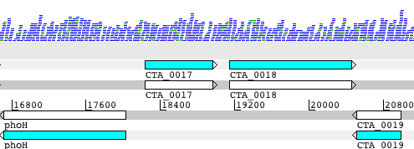
Workflow: generating sequencing reads and in silico analysis
Wet Lab
in silico analysis
FASTQ file
Bacterial cells
Extract DNA
Align reads to reference genome
Break into fragments (~500bp)
*
paired-end reads
Identify SNPs and INDELs,
Generate libraries
view in Artemis
Mapping is aligning a sequence to a known reference to determine genetic differences
DNA extraction and DNA library generation
2

Slide 3
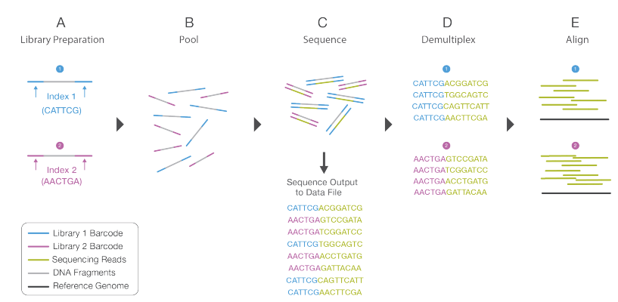
Illumina sequencing reads - fastq
https://emea.illumina.com/content/dam/illumina-marketing/documents/products/illumina_sequencing_introduction.pdf

Slide 4
Sequence output to Demultiplex
FASTQ file
@IL22_1561:1:1:1771:914
TTTTTTCAATACAATTTCATCTCTAATTTCAATTCAGCCTAA
+
>>>>7>>>>>>>>>>>>>>>>>>>:>5>>>96>+>>7;>>>>
@IL22_1561:1:1:1222:1105
ATGATATCATCTACACGGTTTAAAAATTCTGGACGGCTGATC
+
>>;>>>>>>>;>>>>>55>>>>>>>>>>>>+2>>8>>>>>57
@IL22_1561:1:1:1438:709
ACACCGATGACAATAATTGTTCCAATATCTGTAACAAAGCTA
+
<<<<<2<<2<<<<<<<<<)'<<<<<<<<<<+<;;7<)<<2<<
@IL22_1561:1:1:1671:1462
TGCAAGAACATTAGACAACGTATCTTCAATCGTTTATACAAG
+
>>7>:>:>>7>>7/:>>>7/.7>>>>>57>>0>>>>>>7>>>
@IL22_1561:1:1:1168:891
AATGGAAATCAAACTATAACTTCAACACTAAATGAGAAGCTA
+
>>>:7>>>>>>>>>>>>>>>>>>>>>>>>>>>>0>>>>>>>>
@IL22_1561:1:1:1097:1281
TAAAAGTATAACTTTCCATCACCAAAGTCAGAATTTACATCG
+
>>>>>>>>>>>>>>>>>>>>>>>>8>8>>>>>>>>>>>>>>>
TAG Strain
CGTGAT HGSA942
ACATCG 3HK
GCCTAA CHI59
TGGTCA CHI61
CACTGT BK2491
ATTGGC TUR9
GATCTG HU25
TCAAGT HU109
CTGATC HSJ216
AAGCTA FFP103
GTAGCC ICP5062
TACAAG GRE4

Slide 5
Fastq format
1
@SEQ_ID GATTTGGGGTTCAAAGCAGTATCGATCAAATAGTAAATCCATTTGTTCAACTCACAGTTT +
!''*((((***+))%%%++)(%%%%).1***-+*''))**55CCF>>>>>>CCCCCCC65
2
3
4
Line 1 begins with a '@' character and is followed by a sequence identifier and an optional description (like a FASTA title line).
Line 2 is the raw sequence letters.
Line 3 begins with a '+' character and is optionally followed by the same sequence identifier (and any description) again.
Line 4 encodes the quality values for the sequence in Line 2, and must contain the same number of symbols as letters in the sequence.

Slide 6
Fastq quality score/Phred score
The quality (Q), also called phred score, is the probability (P)
that the corresponding basecall is incorrect.

Slide 7
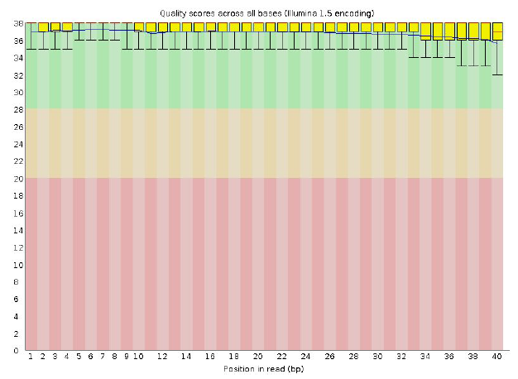
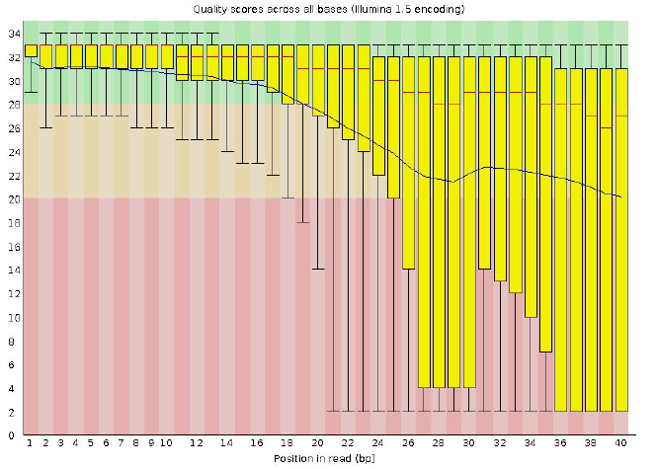
Fastq Quality Check made easy!
Good
Bad
https://www.bioinformatics.babraham.ac.uk/projects/fastqc/

Slide 8
Mapping Illumina sequence data
Isolate - Fastq files
Reference – in fasta format
@IL24_5151:3:1:1553:916#9/1
NAAACTACTTACACCCACTCAGGACACCAGGGACATCATTGCTGACGCCACGGCCTCACAGTGCTGAGCTGATGAT
+
$705291596=>>>>>=>=>=>==>>===>535:6=>=>>>=>==5:;318656:===991/1,-0,0015204.1
@IL24_5151:3:1:2173:904#9/1
NTTTTAACCGTACTTTCACCAGGATTATCGCAGGCGGATTCCTGGTGATTAATTTCAAAAAATAGCGTTTAATCCA
+
$948883999>==>>>>=>>=>>9>>>==>===>=>==>>:;:::===>=55:88>==>9:0;;:===>>==>>>5
@IL24_5151:3:1:2948:912#9/1
NCCACCAGACACTGTCCGCAACCCCGGTAAGGGGCCAACGTTAGAACATCAAACATTAAAGGGTGGTATTTCAAGG
+
>reference sequence
ATTGAACGCTGGCGGCAGGCCTAACACATGCAAGTCGAGCGGCAGCGGGAAGTAGTTT
TACTTTGCCGGCGAGCGGCGGACGGGTGAGTAATGTCTGGGAAACTGCCTGATGGAGG
GATAACTACTGGAAACGGTAGCTAATACCGCATGACCTCGTAAGAGCAAAGTGGGGGAC
TTCGGGCCTCACGCCATCGGATGTGCCCAGATGGGATTAGCTAGTAGGTGGGGTAATGG
TCACCTAGGCGACGATCCCTAGCTGGTCTGAGAGGATGACCAGCCACACTGGAACTGAG
CACGGTCCAGACTCCTACGGGAGGCAGCAGTGGGGAATATTGCACAATGGGCGCAAGC
GATGCAGCCATGCCGCGTGTGTGAAGAAGGCCTTCGGGTTGTAAAGCACTTTCAGCGAG
AGGAAGGCAGTCGTGTTAATAGCACGATTGATTGACGTTACTCGCAGAAGAAGCACCGGC
Choose your reference sequence wisely
You won’t find things in your sample that are not in the reference!
As sequences diverge from the reference, mapping becomes progressively less effective

Slide 9
Why do we map reads to a reference?
Identify variation:
Single Nucleotide Polymorphisms (SNPs),
insertions and deletions (indels)
Copy Number Variants (CNVs) between variants of the same bacteria.
Presence / absence of genes (AMR)

Slide 10
Mappers
There are lots of options
for mapping!
https://academic.oup.com/bioinformatics/article/28/24/3169/245777

Slide 11
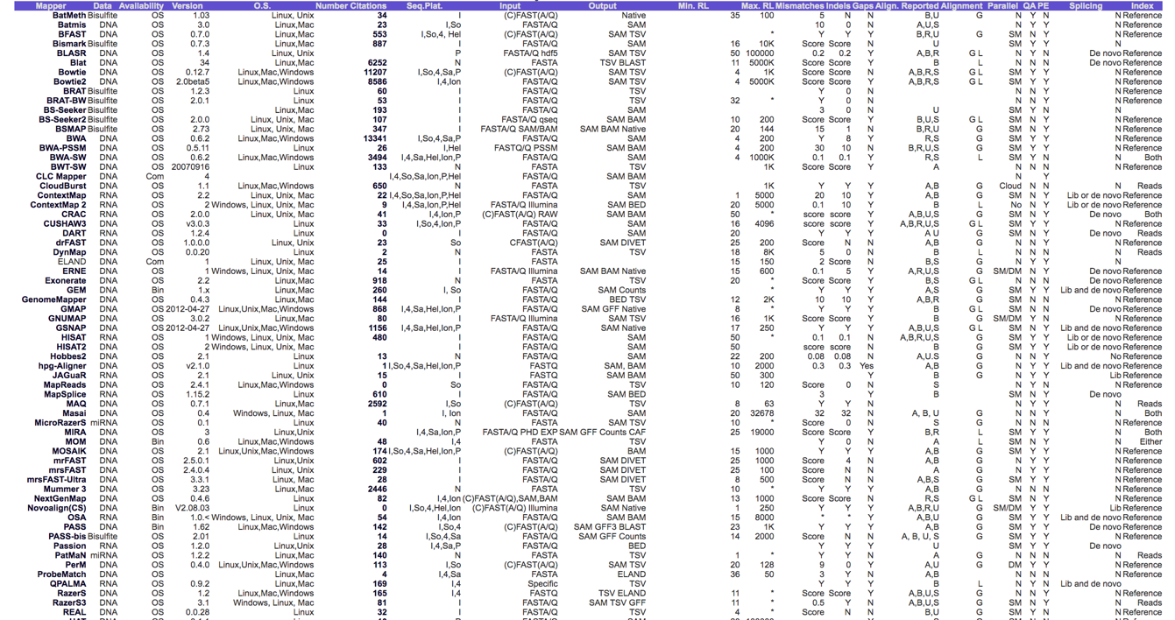
Comparison of different mappers
https://academic.oup.com/bioinformatics/article/28/24/3169/245777

Slide 12
Good general aligners
bwa
bowtie2
minimap2
Fast, sensitive and easy to use!
Splice-aware aligners for RNA-seq
STAR
HISAT2

Slide 13
Why do we map to a reference?
Identify variation:
Single Nucleotide Polymorphisms (SNPs),
insertions and deletions (indels)
Copy Number Variants (CNVs) between variants of the same bacteria.
Presence / absence of genes (AMR)

Slide 14
Single Nucleotide Polymorphisms (SNPs)
https://aschuerch.github.io/MolecularEpidemiology_AnalysisWGS/09-SNPphylo/index.html

Slide 15
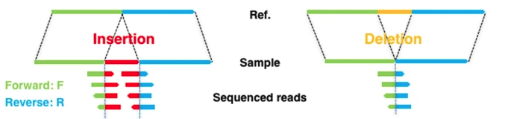
INDELS
https://www.nature.com/articles/s41598-018-23978-z

Slide 16
Visualize in Artemis

Slide 17
Why do we map to a reference?
Identify variation:
Single Nucleotide Polymorphisms (SNPs),
insertions and deletions (indels)
Copy Number Variants (CNVs) between variants of the same bacteria.
Presence / absence of genes (AMR)

Slide 18
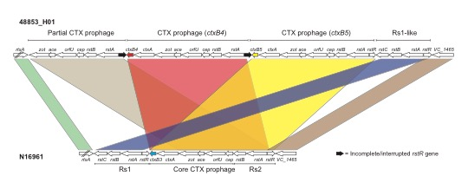
Copy number variation

Slide 19
Gene presence/absence: AMR
Absence/Deletions is easier to spot
*To identify insertions is a little tricky.
Deletion:

Slide 20
Gene insertions/novel genes
In this instance you must investigate:
Metadata (phenotype)
Map to a different reference
If AMR/Virulence – map to a database
Assembly

Slide 22
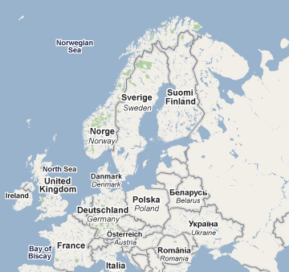
The Swedish Story
Prior to 2006, C. trachomatis in Sweden was following the same pattern as in the UK
In 2006, across Sweden there was a reported drop in cases
Notes:
* Editorial
A new genetic variant of Chlamydia trachomatis
1. Björn Herrmann
1. Correspondence to: Björn Herrmann Department of Clinical Microbiology, Uppsala University Hospital, S-751 85 Uppsala, Sweden; bjorn.herrmann@medsci.uu.se
* Chlamydia trachomatis
* Sweden
A thrilling story in Sweden, with global impact
A new variant of Chlamydia trachomatis was discovered in Sweden in 2006. This variant contains a mutant sequence that cannot be detected with either the Abbott m2000 (Abbott Diagnostics, Chicago, IL, USA) or Cobas Amplicor/TaqMan48 (Roche Diagnostics, Basel, Switzerland) systems. 1 The first description reported that the new variant constituted 13% of all detected chlamydia infections (from mid-September to October 2006) in the county of Halland (south west of Sweden). It soon became apparent that the proportion was higher and that the new variant had spread widely in Sweden. We now know that in the counties that have used the Abbott or Roche test systems during the past year or so the new variant accounts for 20% to 65% of all detected chlamydia cases. In local areas, as many as 78% of all cases have been found to have the mutation (Britta Loré, personal communication).

Slide 23
The Swedish story
It was noticed that counties using the NAATs (Abbott / Roche) diagnostic system showed a drop in C. trachomatis cases in 2006
Counties using other diagnostic methods (BecktonDickinson) still showed an increase in cases, in line with that of previous years
The obvious conclusion was that the NAATs was missing a subset of infections
Why?
Let’s find out using the awesome power of genomic sequencing!!!!

Slide 24
In this session, you will:
Practice short read alignment
View mapped reads in Artemis
Call and view SNPs
Uncover why the PCR test failed for new variant Chlamydia

Slide 25
Today’s exercise
Mapping short read data
Viewing mapped data and variants in the genome using Artemis

